Slide 1

Sthri Raksha – Women Safety App
Auto Alert Emergency System Using Mobile Sensors
A smart safety solution for women
Instant SOS using phone shake
Developed using AI-powered app builder
Presented by: [Your Name] Department: CSE Institution: [College Name]

Slide 2
The Safety Challenge
Women face unsafe situations during:
Night travel
Public transport
Isolated locations
In emergencies:
No time to unlock phone
No time to dial numbers
Panic reduces reaction speed
❌ Existing apps require manual interaction ❌ Help often arrives too late

Slide 3
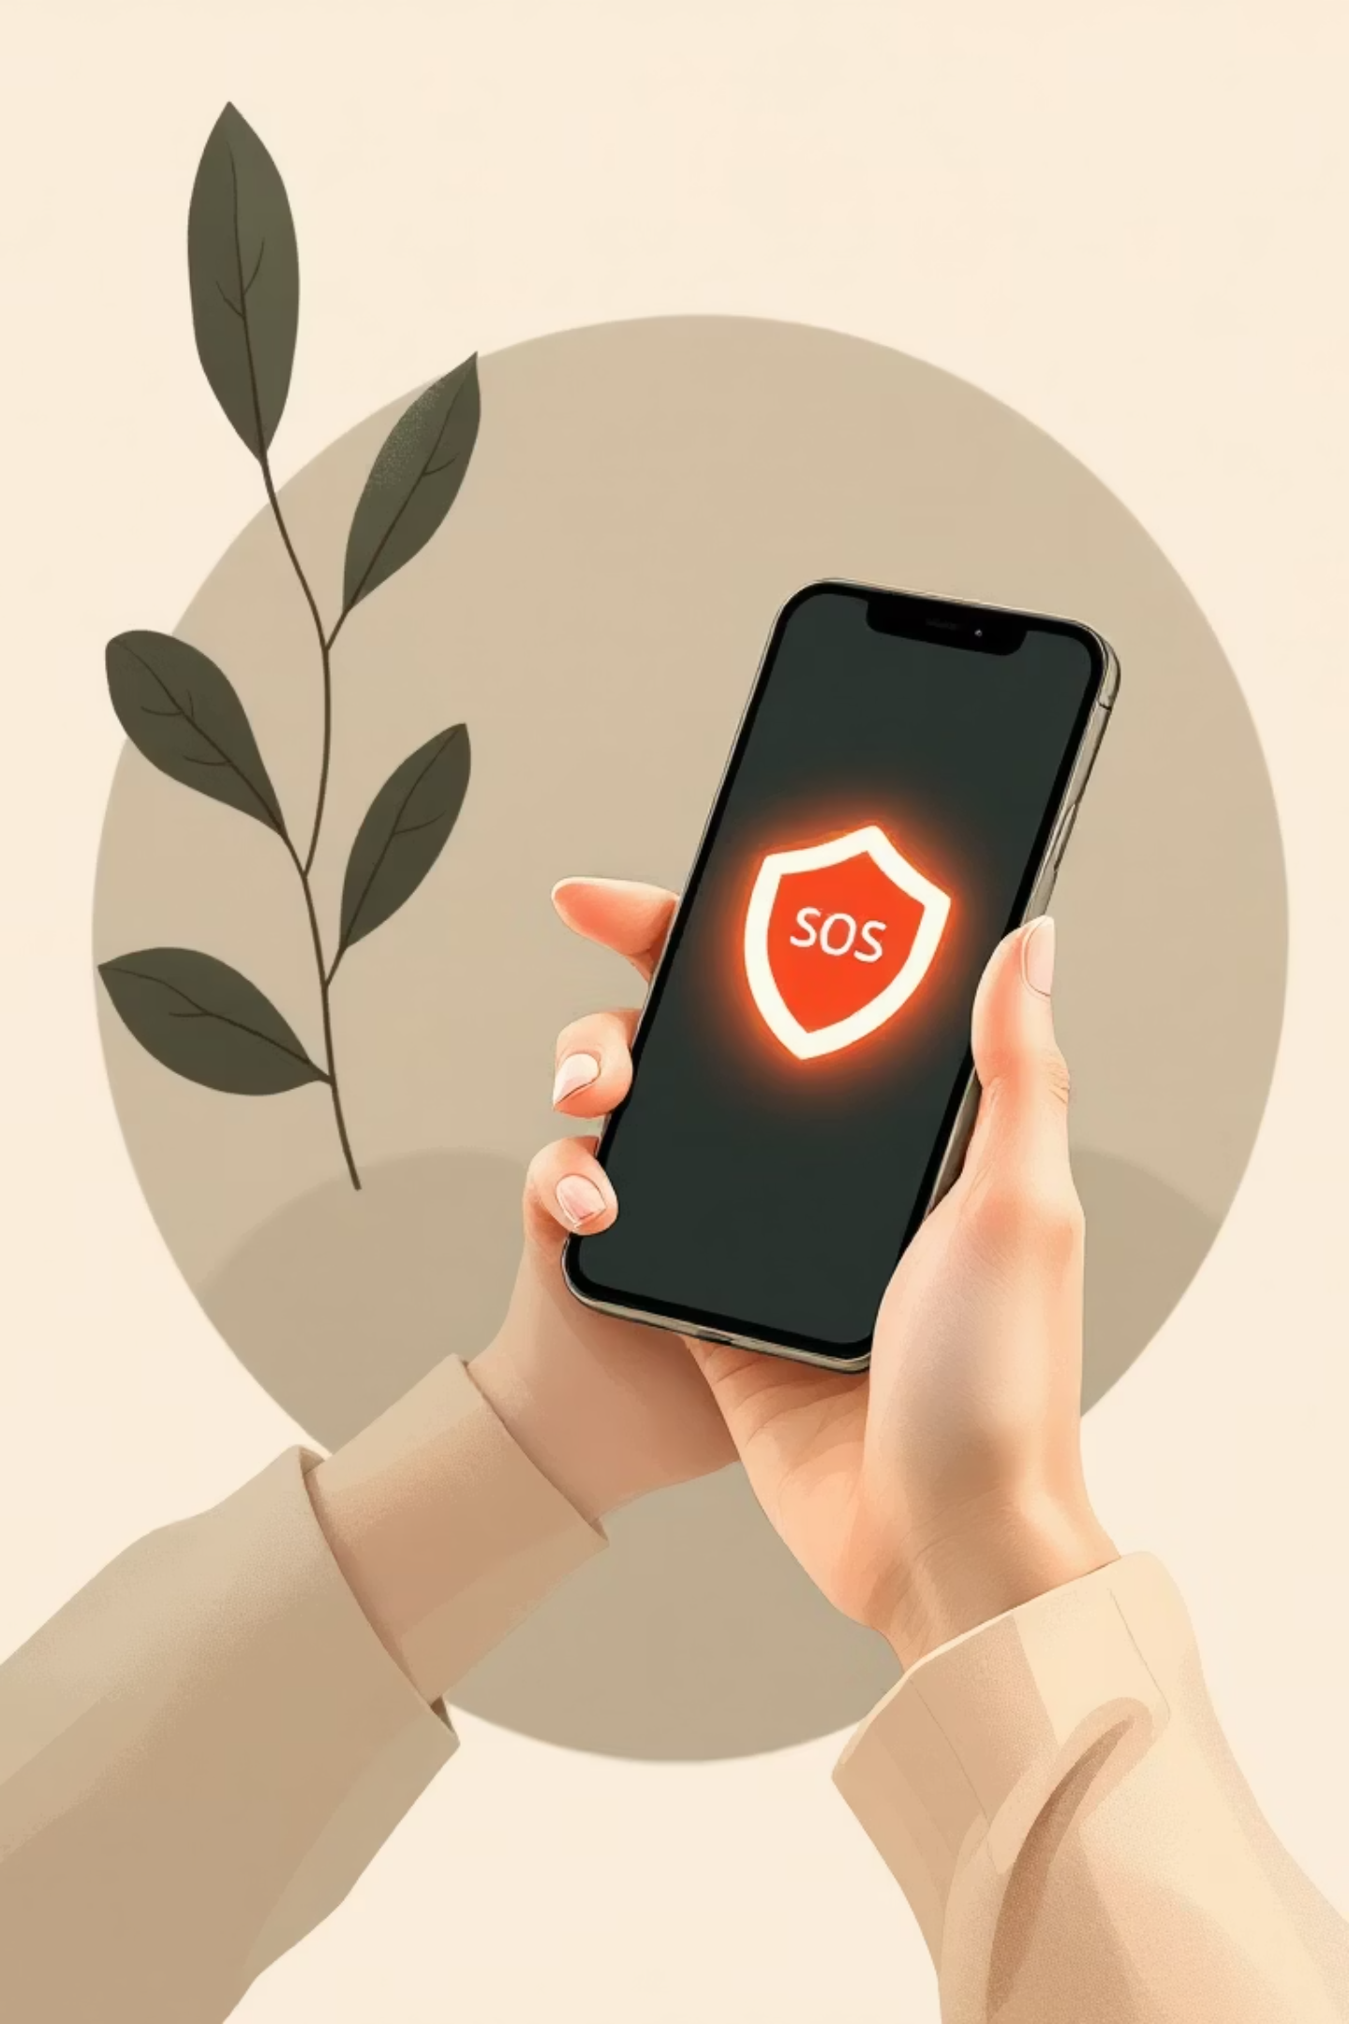
Proposed Solution: Sthri Raksha
Smart Emergency Alert System
A mobile application that:
Detects 5 phone shakes
Automatically triggers:
Emergency call
SOS message
Live location sharing
Works within seconds
🎯 Goal: Fast, touch-free, reliable emergency response

Slide 4





How the System Works
1. User Shakes Phone
5 rapid shakes activate the system.
2. Safety Countdown
An 8-second window to cancel false alerts.
3. User Can Cancel
If it's a false alarm, the user can easily disarm it.
4. Emergency Alerts Sent
If not canceled, alerts are automatically dispatched.
📌 Designed for panic situations

Slide 5
Key Features
Shake-Based SOS
8-Second Cancel
Immediate trigger with a simple gesture.
Avoid accidental alerts with a quick option to disarm.
Auto Emergency Call
SOS Message & GPS
Direct connection to predefined emergency contacts.
Detailed alerts with live location tracking.
Alert History
Simple Interface
Record of past emergencies for review and safety planning.
Intuitive design for ease of use in critical moments.
✅ Works as a demo-ready prototype

Slide 6
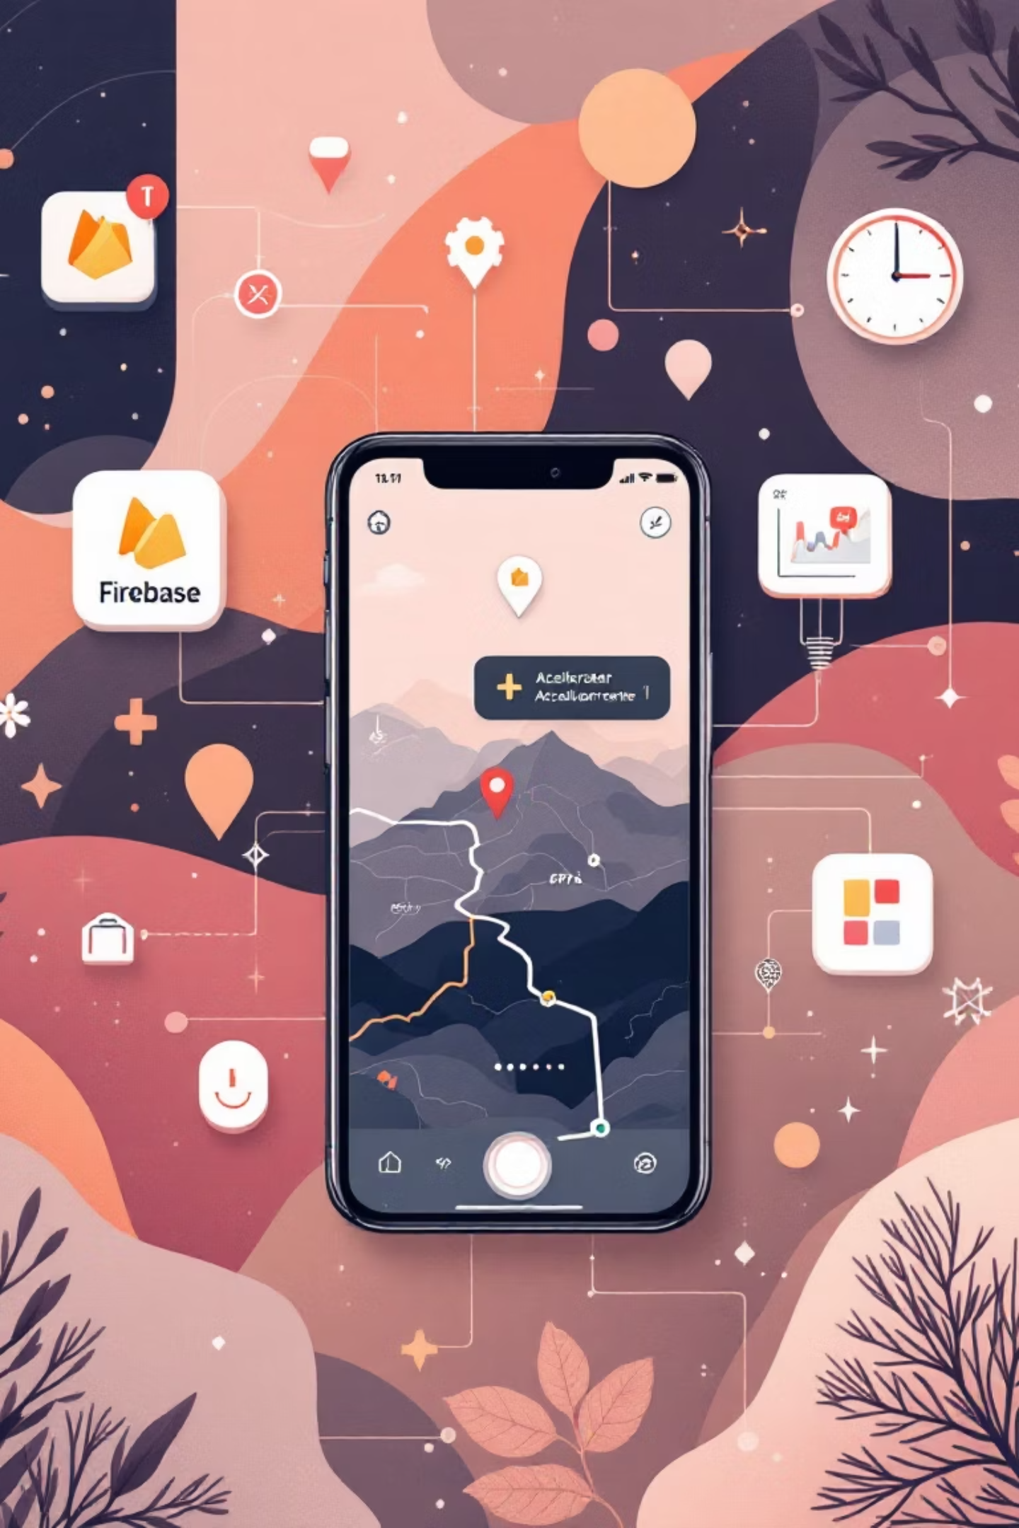
Technologies Used
Frontend
Backend
AI App Builder: Lovable
Firebase (Database & Logs)
Mobile-friendly UI
Location APIs
Device Features
Accelerometer (Shake detection)
GPS (Location)
Telephony (Call/SMS)
🤖 AI-assisted development approach

Slide 7


Market Research & Existing Solutions
Existing Apps
Key Limitations
Our Advantage
Raksha App
Manual button press required
✔ Shake-based activation
bSafe
Complex User Interface
✔ Faster emergency trigger
Government Safety Apps
Delayed response time
✔ Simple & intuitive design

Slide 8

Scope & Applications
Application Scope
Can be used in:
Cities
Women safety
Colleges
Student safety
Public transport
Senior citizen emergencies
Workplaces
Medical emergencies
Solo travelers
🌍 Large social impact potential

Slide 9

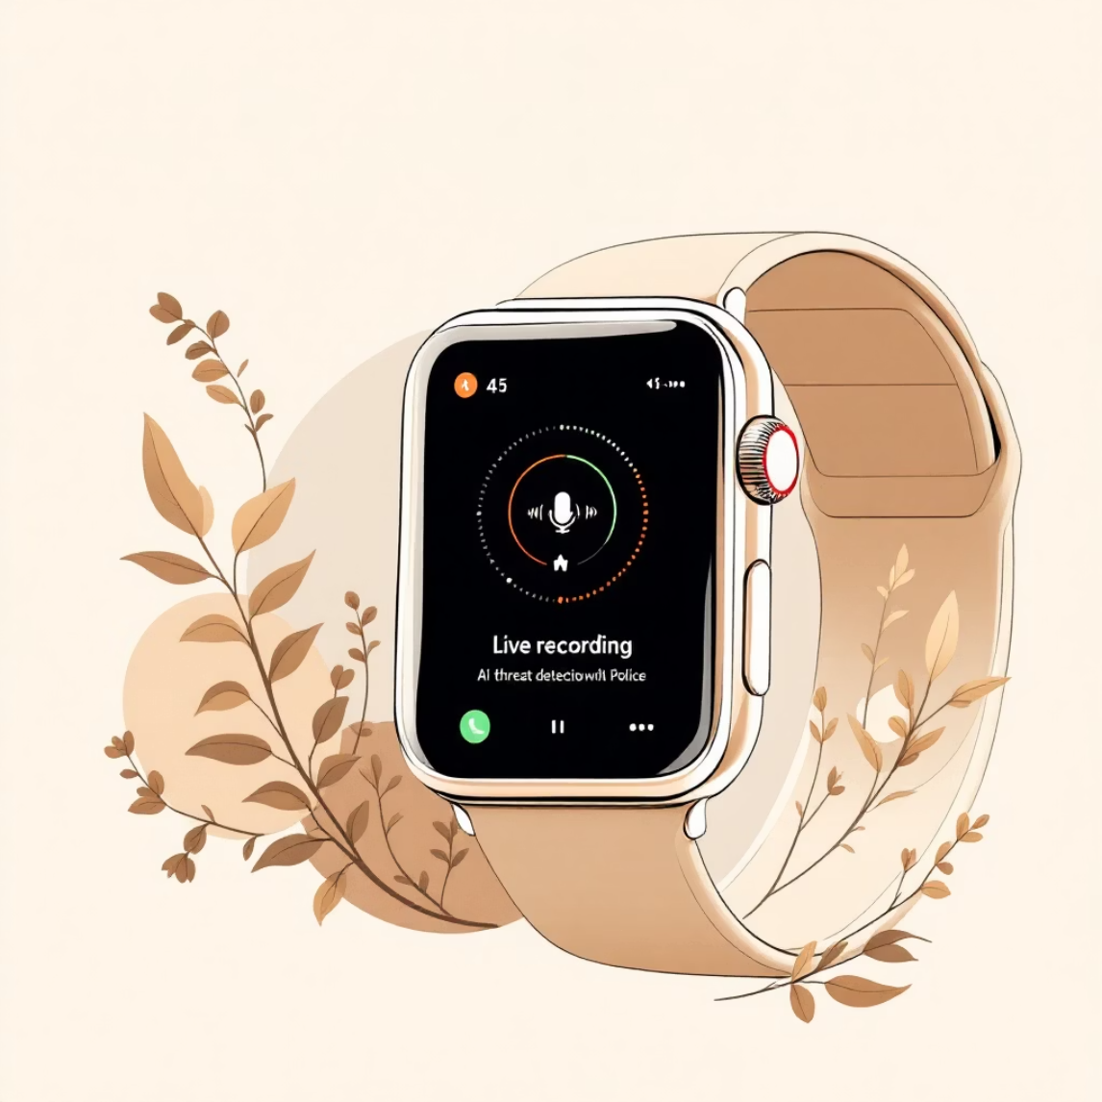
Advantages & Future Enhancements
Advantages
Future Enhancements
No need to open the app
Voice command (“Help me”)
Quick response
Live audio/video recording
Easy to use
Smartwatch integration
Low learning curve
AI threat detection
AI-generated rapid development
Direct police server integration

Slide 10

Conclusion
Sthri Raksha offers a reliable safety solution.
Uses simple gestures to save critical time
AI tools enable rapid and cost-effective development
Ideal for:
College projects
Hackathons
Social-impact startups
Your Safety, Our Priority
🙏 Thank You

